Slide 1
Stepper Motor Basics

Slide 2
What is a stepper motor?
A Stepper Motor or a step motor is a brushless, synchronous motor which divides a full rotation into a number of steps.
Unlike a brushless DC motor which rotates continuously when a fixed DC voltage is applied to it, a step motor rotates in discrete step angles.
The Stepper Motors therefore are manufactured with steps per revolution of 12, 24, 72, 144, 180, and 200, resulting in stepping angles of 30, 15, 5, 2.5, 2, and 1.8 degrees per step.
The stepper motor can be controlled with or without feedback.

Slide 3
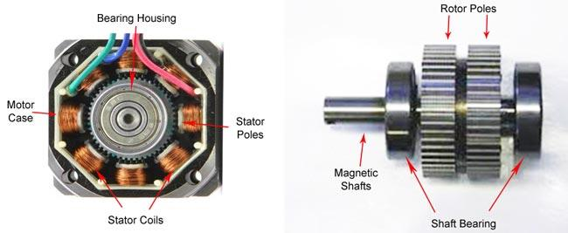
Stepper Motor

Slide 4
How a stepper motor work?
Stepper motors work on the principle of electromagnetism.
There is a soft iron or magnetic rotor shaft surrounded by the electromagnetic stators.
The rotor and stator have poles which may be teethed or not, depending upon the type of stepper.
When the stators are energized the rotor moves to align itself along with the stator (in case of a permanent magnet type stepper) or moves to have a minimum gap with the stator (in case of a variable reluctance stepper).
This way the stators are energized in a sequence to rotate the stepper motor.

Slide 5
Types of stepper motors.
By construction the step motors come into three broad classes:
1. Permanent Magnet Stepper
2. Variable Reluctance Stepper
3. Hybrid Step Motor

Slide 6
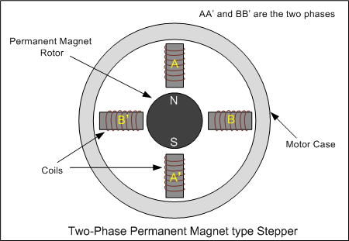
1. Permanent Magnet Stepper Motor
The rotor and stator poles of a permanent magnet stepper are not teethed.
Instead the rotor have alternative north and south poles parallel to the axis of the rotor shaft.

Slide 7
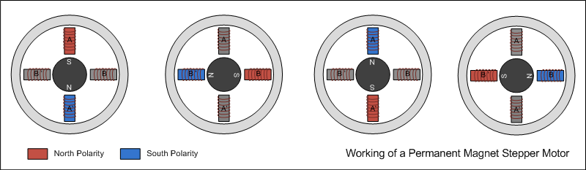
1. Permanent Magnet Stepper Motor
When a stator is energized, it develops electromagnetic poles.
The magnetic rotor aligns along the magnetic field of the stator.
The other stator is then energized in the sequence so that the rotor moves and aligns itself to the new magnetic field.
This way energizing the stators in a fixed sequence rotates the stepper motor by fixed angles.

Slide 8
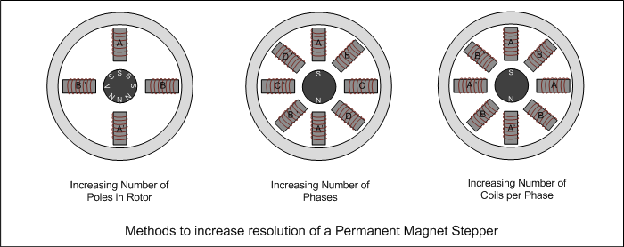
1. Permanent Magnet Stepper Motor
The resolution of a permanent magnet stepper can be increased by increasing number of poles in the rotor or increasing the number of phases.

Slide 9
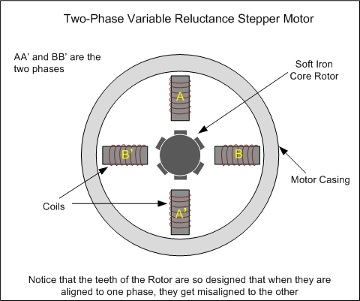
2. Variable Reluctance Stepper Motor
The variable reluctance stepper has a toothed non-magnetic soft iron rotor.
It works on the principle of reluctance, according to which magnetic flux always flows through a minimum reluctance path.

Slide 10
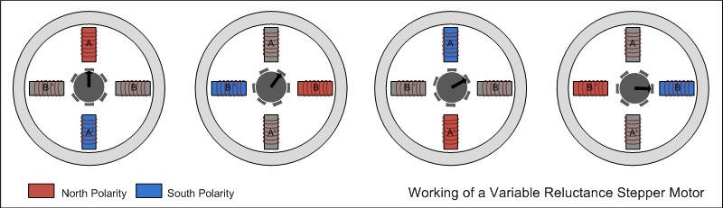
2. Variable Reluctance Stepper Motor
The teeth of the rotor are designed so that when they are aligned with one stator they get misaligned with the next stator.
Now when the next stator is energized, the rotor moves to align its teeth with the next stator.
This way energizing stators in a fixed sequence completes the rotation of the step motor.

Slide 11
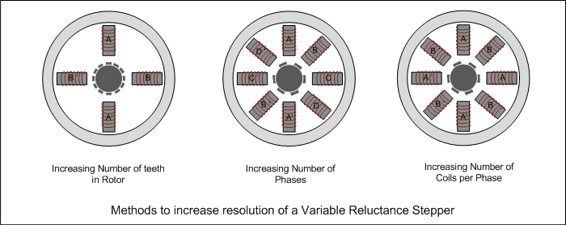
2. Variable Reluctance Stepper Motor
The resolution of a variable reluctance stepper can be increased by increasing the number of teeth in the rotor and by increasing the number of phases.

Slide 12
2. Variable Reluctance Stepper Motor
The resolution of a variable reluctance stepper can be increased by increasing the number of teeth in the rotor and by increasing the number of phases.

Slide 13
2. Variable Reluctance Stepper Motor- Construction
The stator poles are made of silicon steel.
Since the main role of stator poles is to produce a magnetic field, they are made of good magnetic material. The windings are made of copper.
The rotor windings are made of ferromagnetic material. The ferromagnetic material has the property of least reluctance.
Whenever a ferromagnetic material is placed under the influence of the magnetic field, then the magnetic field lines completely pass through the material. No magnetic flux passes through the air.

Slide 14
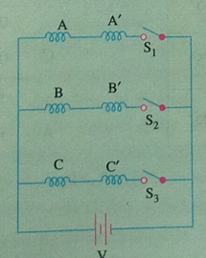
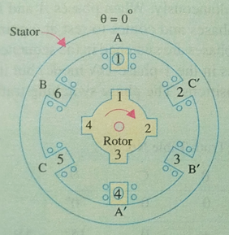
Variable Reluctance Stepper Motor – Full step operation (1-Phase ON)

Slide 15
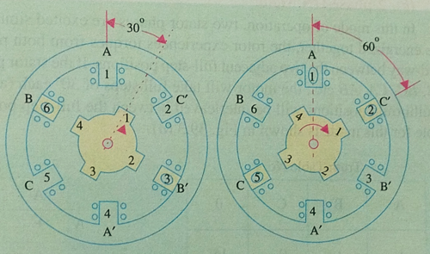
Variable Reluctance Stepper Motor – Full step operation

Slide 16
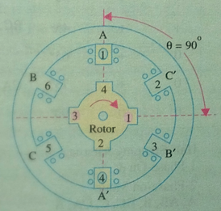
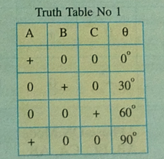
Variable Reluctance Stepper Motor – Full step operation

Slide 17
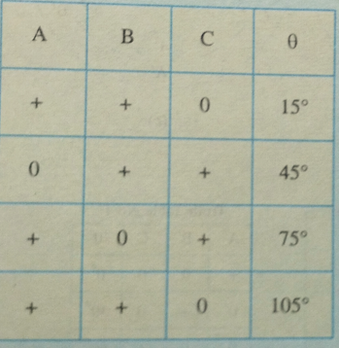
Variable Reluctance Stepper Motor – 2 Phase ON

Slide 18
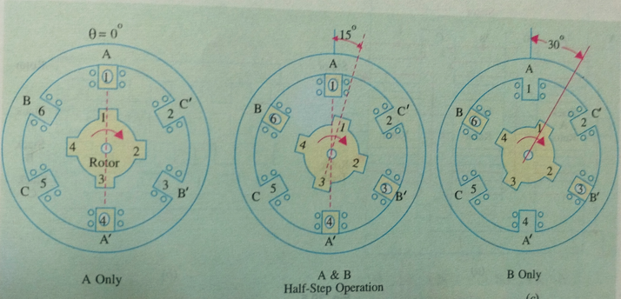
Variable Reluctance Stepper Motor – Half step operation

Slide 19
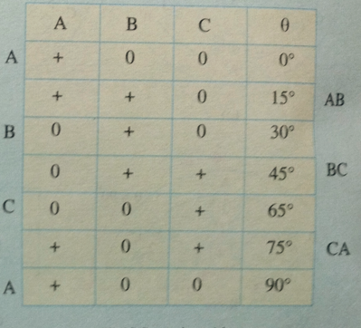
Variable Reluctance Stepper Motor – Half step operation

Slide 20
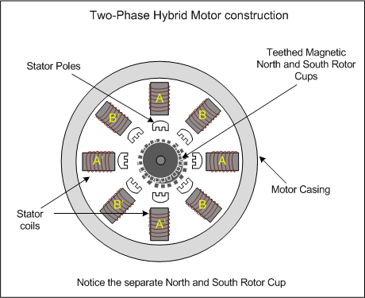
2. Hybrid Stepper Motor
A hybrid stepper is a combination of both permanent magnet and the variable reluctance.
It has a magnetic teethed rotor which better guides magnetic flux to preferred location in the air gap.

Slide 21
Multi-stack VR stepper motor
A Multi Stack or m stack variable reluctance stepper motor is made up of m identical single stack variable reluctance motor.
The rotor is mounted on a single shaft. The stator and rotor of the Multi Stack Variable motor have the same number of poles.
the rotor poles are displaced by 1/m of the pole pitch angle from each other.
The number of phases and the number of stacks are the same.
There are 12 stator and rotor poles in each stack. The step angle is 30 degrees.

Slide 22
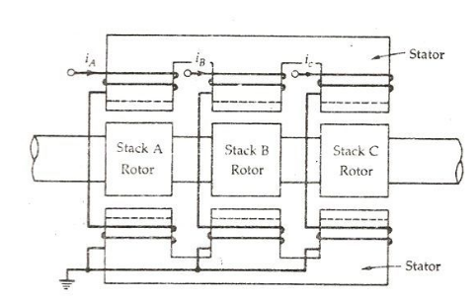
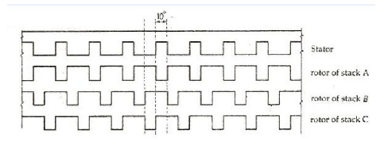
Multi-stack VR stepper motor

Slide 23
Multi-stack VR stepper motor - Working
When the phase winding A is excited the rotor teeth of stack A is aligned with the stator teeth.
When phase A is de-energized, and phase B is excited, rotor teeth of stack B are aligned with the stator teeth and the movement is 10 degrees in the anticlockwise direction.
When phase B is de-energized, and phase C is excited, the rotor moves another step of 1/3 of the pole pitch in the anticlockwise direction.
During this whole process (A – B – C – A ) the rotor has moved one rotor tooth pitch (30 degrees ).

Slide 24
2. Hybrid Stepper Motor
A hybrid stepper motor is a combination of the variable reluctance and permanent magnet type motors.
The rotor of a hybrid stepper motor is axially magnetized like a permanent magnet stepper motor, and the stator is electromagnetically energized like a variable reluctance stepper motor.
Both the stator and rotor are multi-toothed.
A hybrid stepper motor has an axially magnetized rotor, meaning one end is magnetized as a north pole, and the other end a south pole.
Toothed rotor cups are placed on each end of the magnet, and the cups are offset by half of a tooth pitch.

Slide 25
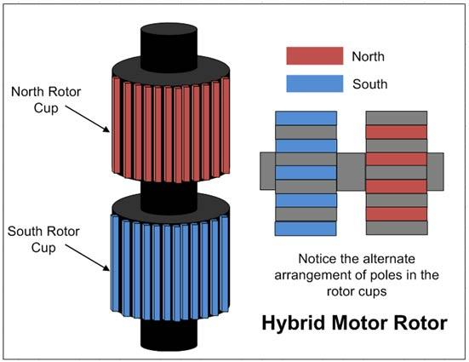
2. Hybrid Stepper Motor
The magnetic rotor has two cups. One for north poles and second for the south poles.
The rotor cups are designed so that that the north and south poles arrange in alternative manner.

Slide 26
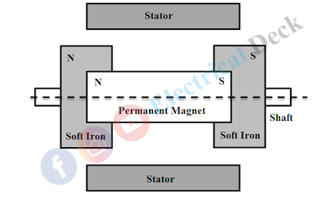
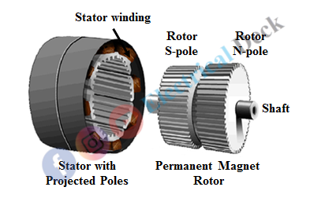
2. Hybrid Stepper Motor- construction

Slide 27
2. Hybrid Stepper Motor- construction
The rotor consists of a permanent magnet placed axially on the rotor shaft with axial pairs of poles N and S
Two identical stacks of soft iron also called end-caps are attached to the two ends (N and S) of the axially magnetized permanent magnet.
These iron stacks consist of tooth-like projections and are magnetized by the axial permanent magnet to which they are attached.
Thus, iron stacks or rotor teeth on one end become the north pole while the other with a south pole.

Slide 28
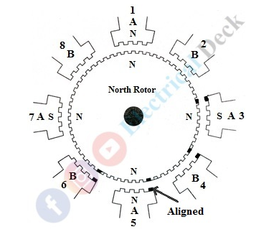
2. Hybrid Stepper Motor- Working
https://www.electricaldeck.com/2021/01/hybrid-stepper-motor-construction-working-applications.html

Slide 29
2. Hybrid Stepper Motor- Working
Each stator pole consists of 2 to 6 projected teeth as shown below.
The rotor is made up of composed tooth cups of a permanent magnet.
The torque is produced due to the interaction of rotor flux with the stator flux and is proportional to the stator exciting current.
The stator has a two-phase construction (Phase-A and Phase-B). The winding coils are placed at 90° from one another.
Each phase is wound so that the poles 180° apart are with the same polarity, while the poles 90° apart are with opposite polarity.

Slide 30
2. Hybrid Stepper Motor- Working
Poles 1, 3, 5, and 7 forms phase A and poles 2, 4, 6, and 8 form phase B.
When phase A is excited, the poles 1 and 5 are energized with the pole N and the poles 3 and 7 with the pole S.
This makes rotor pole N align with stator pole S (i.e., 3 and 7) and rotor pole S with stator pole N (i.e., 1 and 5).
Suppose, if phase B is excited the rotor will make a step by one-quarter of a tooth pitch.
The poles to be energized will depend upon the direction of rotation to be done by the rotor.

